Slide 1
PowerPoint Tips and Tricks

Slide 2
Pieces to put together
Ribbon
Videos
Animations
Transitions
Templates
Themes
Presenting
Stump the Expert
Images
Notes:
Slide number /Title
3 Ribbon
5 Images
7 Videos
9 Animations
12 Transitions
14 Templates/themes
18 Presenter tips
21 PPT FAQ
22 Stump the Expert

Slide 3
Ribbon

Slide 4
What is the ribbon?
Ribbon
Tab
Group
Button/ Gallery
Ribbon Hero

Slide 5
Images

Slide 6
My Grandson ☺
Let’s make it better
Notes:
Remove background
Angle
Frame
Reflect
ETC.

Slide 7
Videos

Slide 8
Two sides…
Add video
Record presentations
Notes:
Add
Edit
Format
Use this as a place to demo Selection pane as well
Record/Save as video

Slide 9
Animations

Slide 10
Working with animations
Notes:
Talk through the interface and the animation task pane

Slide 11
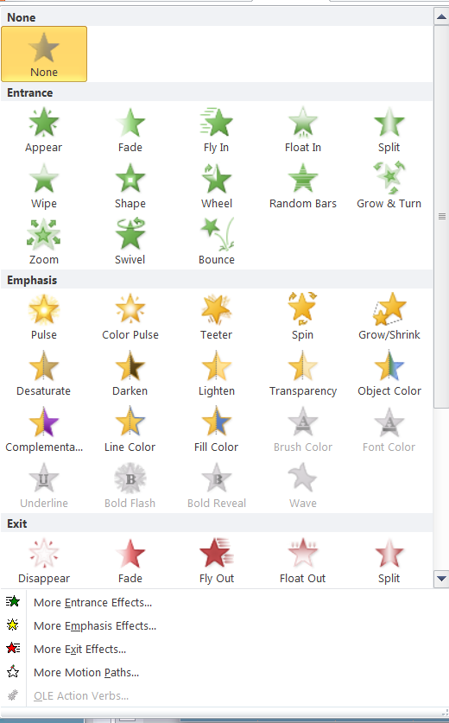
What animations are available?
Notes:
Talk about the gallery and how to use it
Talk through how these two animations were done

Slide 12
Transitions

Slide 13
Transitions are…
Movements and effect for moving into a slide which can be:
Static or dynamic
Timed or on click
On a single slide or a whole presentation
Notes:
Explain, then demo both static and dynamic

Slide 14
Templates/Themes

Slide 15
Differences
Templates
Themes
Backgrounds
Layouts
Templates
Colors
Fonts
Effects
Notes:
Talk about the two of them…

Slide 16
Layouts and masters
Layouts
Masters
How the pieces of a slide come together
Where and what content goes on a slide
Look, feel, and design
The back layer

Slide 17
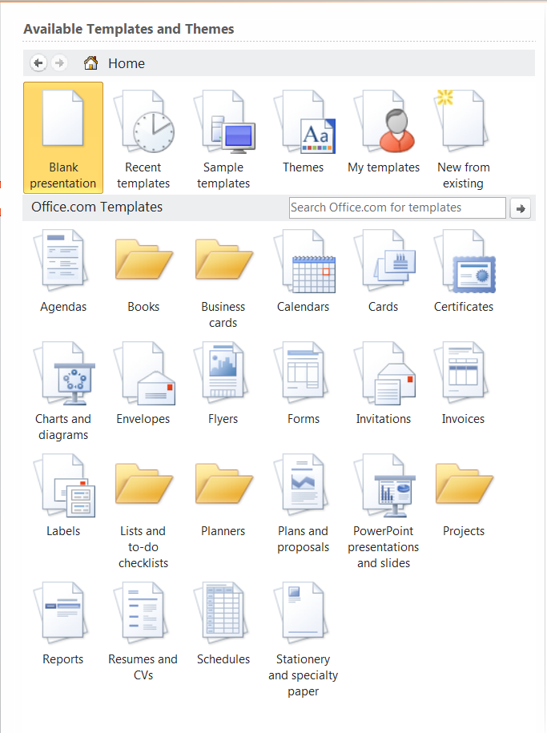
Sources
Inside PPT
Office Online
Maniactive
Indezine
The PowerPoint Blog
Ellen Finkelstein

Slide 18
Presenting

Slide 19
Make your life easier
Notes
F1 for shortcuts
Presenter view
Preview animations and transitions
PRACTICE PRACTICE PRACTICE

Slide 20
Keep the focus on the audience!
For the best results:

Slide 21
The PPT FAQ http://pptfaq.com
And finally…
Your friend for all things PowerPoint:

Slide 22
Stump the Expert!
Your turn!

